Slide 1
Getting Started with SharePoint Development
Ryan Schouten
SharePoint Fest Seattle 2016

Slide 2





Ryan Schouten
Worked with SharePoint for > 9 years
I have experience with SharePoint 2003 – 2016
I have worked with ASP.Net for 15 years
MCPD, MCT, MCSE: SharePoint, MCSA: Office 365
Contact Information
Ryan@sharepointknight.com
@shrpntknight
http://www.sharepointknight.com

Slide 3

Office365 Implementations
Custom SharePoint Development
Responsive Design
Intranet Design/Implementations

Slide 4
Agenda
8:30 – 8:45 Introductions
8:45 – 9:30 SharePoint Basics
9:30 – 9:45 Break
9:45 – 10:45 Development Options
10:45 – 11:00 Break
11:00 – 12:00 Client-Side Development

Slide 5
SharePoint Basics
Items and Files
Web Application
Site Collection
Web Site
Lists and Libraries

Slide 6
Site Collection
Contains A Web Site at its Root
Boundary for a lot of SharePoint
Security
Content Access
Databases

Slide 7
Web Site
Actually holds the content
Content is stored in lists and libraries
Can Contain Sub Sites

Slide 8
Lists and Libraries
Content inside SharePoint Stored in List Items and Files
They are like data tables/Excel Sheets
Allow storing of data with user definable fields

Slide 9
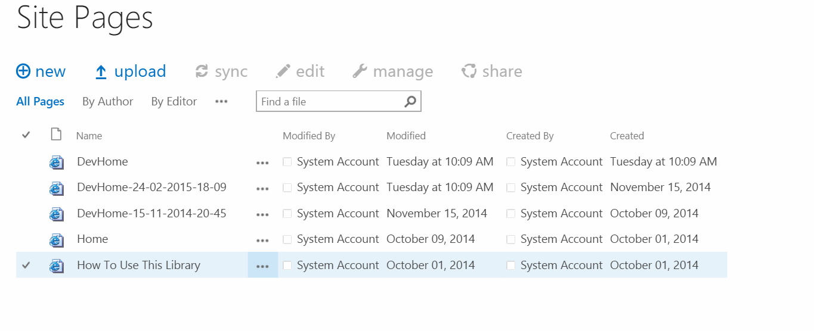
Views
Allows Users to Customize How Data is Viewed
Includes the Following Functionality
Grouping
Sorting
Filtering
Paging

Slide 10
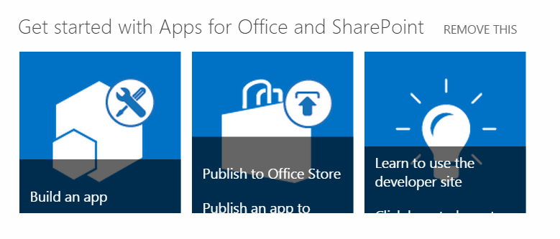
Web Parts
Web Parts are how SharePoint Displays Content
List Views are a Web Part

Slide 11
Workflows
Allows for Process Automation
SharePoint includes out of the box approvals
Approval
Collect Feedback
Collect Signatures
Publishing Approval
Three State
We can create our own

Slide 12
Search
Indexes Content for Quick Retrieval
Content is Cross Farm
Can Include Content from Non SharePoint Sources
Search can look across Millions of records in sub-second responses

Slide 13
Business Connectivity Services
Allows us to expose data from external systems in SharePoint as if it was Stored there
This can be data stored in:
SQL Server
Web Services
Oracle(with Custom Code)
Any .Net Accessible source

Slide 14
Enterprise Content Management
Allows Publishing and Approval of Content
Gives us the ability to use page layouts
Routing of content
Records Management

Slide 15
Security
Permissions can be granted to
Groups
Users
Apps
Groups can contain:
Users
AD Groups
Apps
Permissions Inherit by default but inheritance can be broken

Slide 16
Different Ways of customizing SharePoint
Visual Studio
Full Trust Solution
Sandbox Solution
SharePoint Apps/Add Ins
Napa
SharePoint Apps/Add Ins
SharePoint Designer
Allows Easy Modification of SharePoint Items
Workflows

Slide 17

Full Trust Solutions
Allows Full Access to the SharePoint Environment
Can use VB.Net or C#
Allows the greatest degree of customization but can also cause the most harm
Files can be deployed to the SharePoint file system
Deployed as .wsp(really a cab)

Slide 18

Sandbox Solutions
Predecessor to SharePoint Apps
Allowed deployment of SharePoint resources
Admins could limit the amount of server resources solutions to prevent server degradation
Deployed as .wsp(really a cab)

Slide 19
SharePoint Apps/Add Ins
New to SharePoint 2013
Can be sold through the SharePoint App Store
Two Hosting Methods available
SharePoint Hosted
Provider Hosted
Deployed as .app(really a zip file)

Slide 20
Comparison
 | Full Trust | Sandbox | SharePoint Hosted App | Provider Hosted App
Server Side Code
Client Side Code
Server Side Object Model
Client Side Object Model
Custom Lists/Modules
Languages | VB.Net/C#/ JavaScript | VB.Net/C#/ JavaScript | JavaScript | Any Web Language
Availability | On Premise | On Premise/ Office 365 | On Premise/ Office 365 | On Premise/ Office 365

Slide 21
Working with SharePoint
Several Methods available for working with SharePoint
Server Side Object Model
Client Side Object Model
Web Services
REST

Slide 22
Server-Side Object Model
Full access to SharePoint
Pretty much if SharePoint can do it so can you
Watch for memory leaks.
If you create it and can dispose it, do so.
Items and Files - SPListItem
Web Application - SPWebApplication
Site Collection - SPSite
Web Site - SPWeb
Lists and Libraries - SPList

Slide 23
Client-Side Object Model
Comes in Several Flavors
.Net
Silverlight
JavaScript
Windows Phone
Allows Batching of Requests
Uses a lot of the same class names and methods

Slide 24
REST
Allows Quick Access to SharePoint Resources through URLs
Allows most Odata operators
Filter
Select
OrderBy
Etc.
http://sharepoint/_api/web

Slide 25
Compare
 | Server Side Object Model | Client Side Object Model | REST
Access SharePoint Objects
Run with Admin Priviledges
Can Be Used in the Browser
Full SharePoint Access
Availability | On Premise | On Premise/Office 365 | On Premise/Office 365

Slide 26
Break

Slide 27
Development Options
Solutions
Add-ins
SharePoint Hosted Add-Ins
Provider Hosted Add-Ins

Slide 28
Solutions
On-Premise Can Deploy Code
Client-Side and Server-Side
Deployable Components

Slide 29
Deployable Components
Modules
XML Files
List Definitions
Web Parts
Content Types
Site Columns
Features

Slide 30
Modules
Allow files to be deployed to the SharePoint Database
File Types
JavaScript
CSS
HTML
aspx

Slide 31
XML Files
List Definitions
Allows deployment for templated lists
Web Parts
XML Files defining web parts
Content Types
Allows us to define what makes up types of items
Site Columns
Allows definition of reusable fields
Event Receivers
Perform actions when event happen, item created, site created/updated/deleted, etc.

Slide 32
FEatures
Allows the activating of functionality
Be careful about what is put into your features
Features is how previous items are deployed

Slide 33
Server-Side Code
Available for On-Premises SharePoint
Allows creation of custom functionality
Deployed to file system
If SharePoint can do it we can
This is how MS adds functionality to SharePoint

Slide 34
Demo Solutions

Slide 35
Add-Ins
New Method for SharePoint 2013+
Hosting Methods
SharePoint Hosted
Provider Hosted

Slide 36
Demo Add-Ins

Slide 37
Break

Slide 38
Client-Side Development
Available in Office365 and On-Premise
Methods
REST
CSOM
Web Services

Slide 39
Client-Side Object Model
Comes in Several Flavors
.Net
Silverlight
JavaScript
Windows Phone
Allows Batching of Requests
Uses a lot of the same class names and methods

Slide 40
REST
Allows Quick Access to SharePoint Resources through URLs
Allows most Odata operators
Filter
Select
OrderBy
Etc.
http://sharepoint/_api/web

Slide 41
Web Services
Allows Calling a lot of functionality that is unavailable in other methods
Easiest to implement with existing libraries
Ideal for working with calendars with recurring events

Slide 42
Demo: Family Feud

Slide 43

Questions

Slide 44
Thanks
Thank your for attending SharePoint Fest
Contact Information
Ryan@sharepointknight.com
@shrpntknight
http://www.sharepointknight.com

